Slide 1
How to use local parameter fields (local fields) in Alma Analytics
Yoel Kortick
Senior Librarian

Slide 2

Agenda
Introduction
Defining the fields
The sample records
The results in analytics
Using the analytics_display_local_params parameter

Slide 3
Introduction

Slide 4
Introduction
In addition to the many bibliographic and holdings fields which are already included in Alma Analytics it is possible to also add:
  Up to 30 additional fields to the “Bibliographic Details” folder
  Up to 10 additional fields to the “Holding Details” folder
The fields which the institution adds to the “Bibliographic Details” and / or “Holding Details” folder are called “local_param” fields.
These local_param fields do not have to include a “9” in any of the positions.

Slide 5
Defining the fields

Slide 6
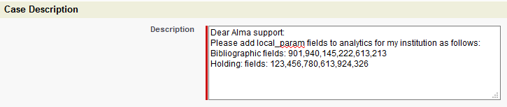
Defining the fields
In order for your institution to have the local_param fields you must open a Sales Force Case and request from support to add the fields.

Slide 7
Defining the fields
As we can see in this example, some of the fields do have a “9” and some of the fields do not have a “9”
Dear Alma support:
Please add local_param fields to analytics for my institution as follows:
Bibliographic fields: 901,940,145,222,613,213
Holding: fields: 123,456,780,613,924,326

Slide 8
Defining the fields
In the next two slides we will see that the following has been defined for this specific institution:
Local Bibliographic fields for analytics:
  Local_parameter_1 932
  Local_parameter_2 938
  Local_parameter_3 940
  Local_parameter_4 982
  Local_parameter_5 984
  Local_parameter_6 927
  Local_parameter_7 981
Local Holdings fields for analytics
  Local_parameter_1 866
  Local_parameter_2 852
  Local_parameter_3 970
  Local_parameter_4 971

Slide 9
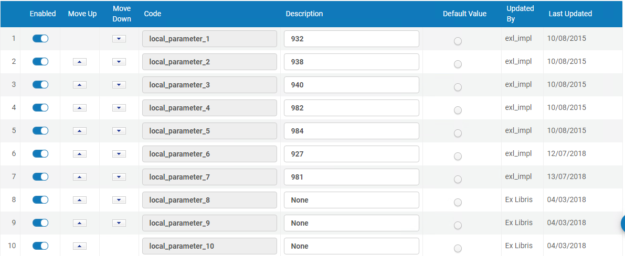
Defining the fields
Ex Libris makes the appropriate definitions in code table ‘Local Parameters for Reports’ and runs appropriate indexing. Bibliographic fields:

Slide 10
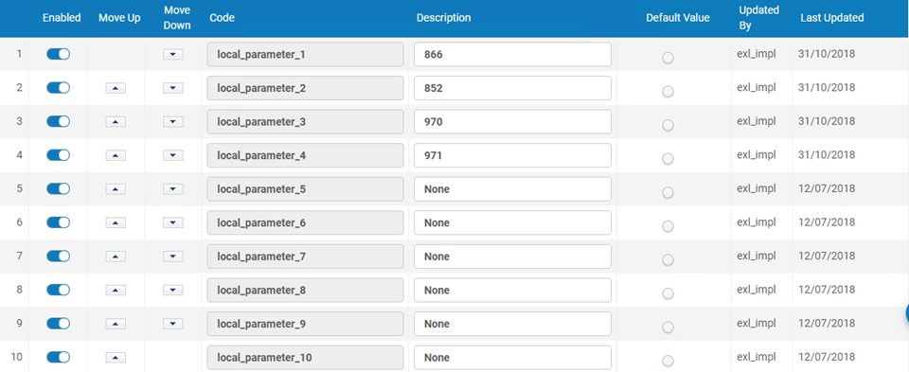
Defining the fields
Ex Libris makes the appropriate definitions in code table ‘Holding Local Parameters for Reports’ and runs appropriate indexing. Holdings fields:

Slide 11
The sample records

Slide 12
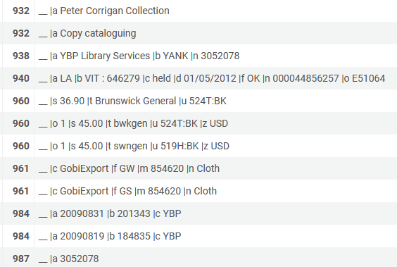
The sample records
Here is bibliographic record MMSID 999640900001341 with local fields
Fields defined as local_param fields are in red squares

Slide 13
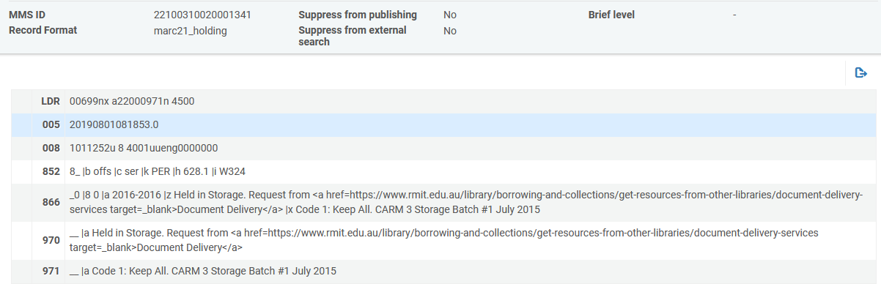
The sample records
Here is holdings record ID 22100310020001341 with local fields
Fields defined as local_param fields are in red squares

Slide 14
The results in analytics

Slide 15
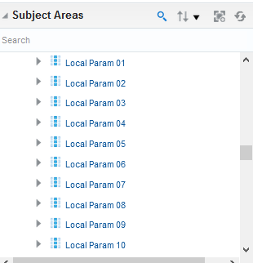
The results in analytics
Here are the (the first 10) bibliographic record local_param fields (in the shared folder “Bibliographic details)

Slide 16
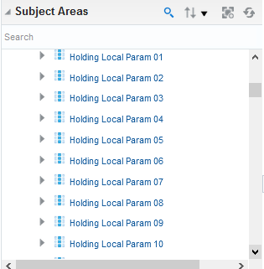
The results in analytics
Here are the holdings record local_param fields (here we are looking in the physical items subject area)

Slide 17
The results in analytics
Here is the bibliographic record in analytics with local parameter fields
Note that we will soon see that it is also possible to have the MARC field displayed together with the text “Local Param nn”

Slide 18
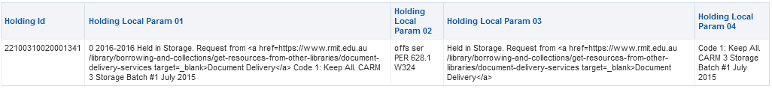
The results in analytics
Here is the holdings record in analytics with local parameter fields

Slide 19
The results in analytics
Here is the bibliographic record in Alma and in analytics

Slide 20
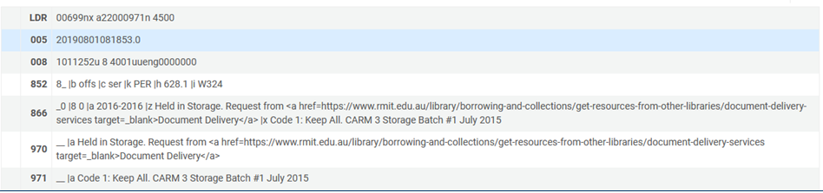
The results in analytics
Here is the holdings record in Alma and in analytics

Slide 21
Using the analytics_display_local_params parameter

Slide 22
Using the analytics_display_local_params parameter
It is possible to have the specific field of the local parameters displayed in analytics together with the text “Local Param nn”
This can be configured using the parameter analytics_display_local_params at “Configuration > Analytics > General Configuration > Other Settings”
  If defined as “false” then the text “Local Param nn” will appear.
  If defined as “true” then the actual field name (MARC value) followed by the text “Local Param nn” will appear. This is useful so that the analytics designer and consumer will know what field is being used.

Slide 23
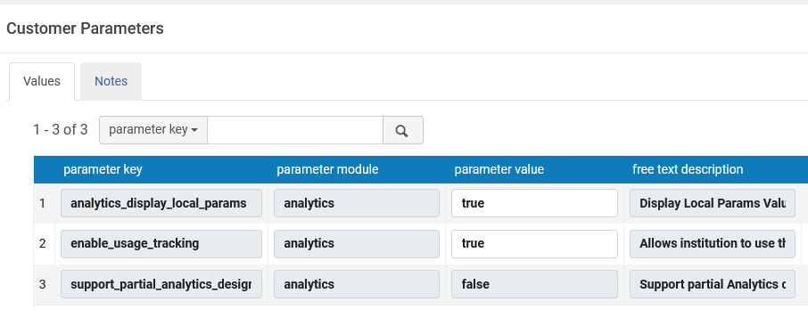
Using the analytics_display_local_params parameter
This institution has the parameter defined as “true”

Slide 24
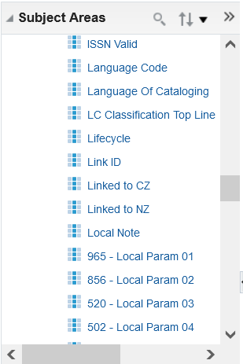
Using the analytics_display_local_params parameter
In analytics the local parameters appear as “{Field} - Local Param nn”
analytics_display_local_params = true

Slide 25
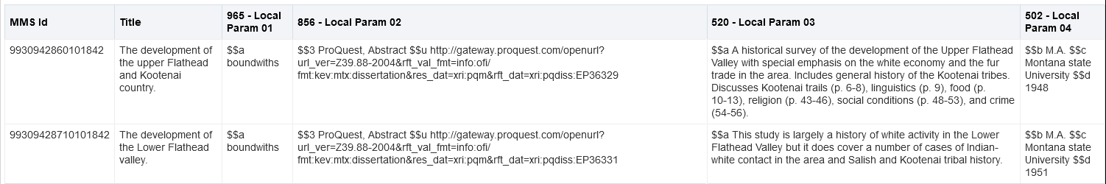
Using the analytics_display_local_params parameter
In analytics the local parameters appear as “{Field} - Local Param nn”
analytics_display_local_params = true

Slide 26
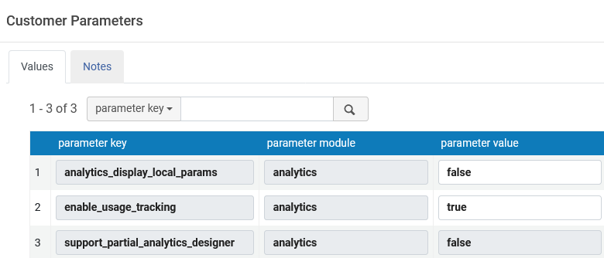
Using the analytics_display_local_params parameter
This institution has the parameter defined as “false”

Slide 27
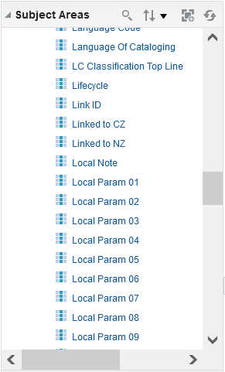
Using the analytics_display_local_params parameter
In analytics the local parameters appear as “Local Param nn”
analytics_display_local_params = false

Slide 28
Using the analytics_display_local_params parameter
In analytics the local parameters appear as “Local Param nn”
analytics_display_local_params = false

